Slide 1
EECT 122 Lab NOtebook
Cohlten Green
Lab Partner: Evan Wilson

Slide 2
Table of contents
Week 2 3
Week 5 24
Lab 9 49
Week 5 54
Week 6 59
Week 8 61
Week 9 63
Week 10 64
Week 11 67
Week 12 68
Week 13 70
Week 14 72
Week 15 73

Slide 3
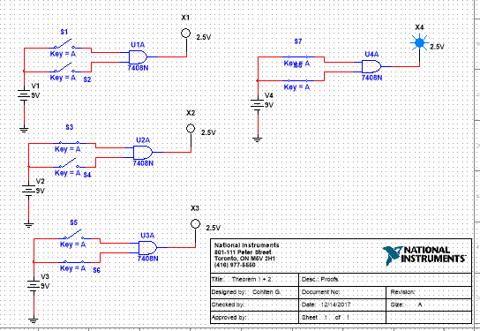
Week 2
Boolean theorems
Review
Proofs 1 and 2

Slide 4
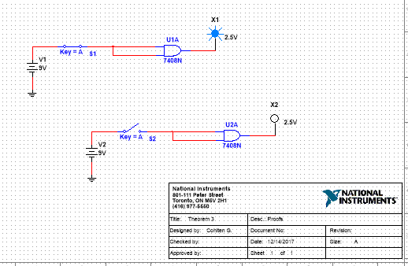
Week 2
Boolean theorems
Review proof 3

Slide 5
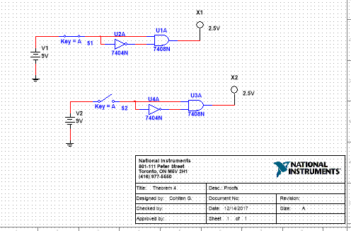
Week 2
Boolean theorems
Review proof 4

Slide 6
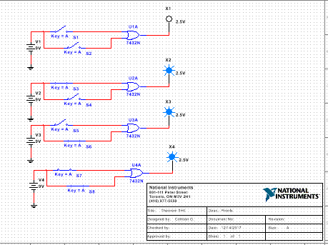
Week 2
Boolean theorems
Review proof 5 and 6

Slide 7
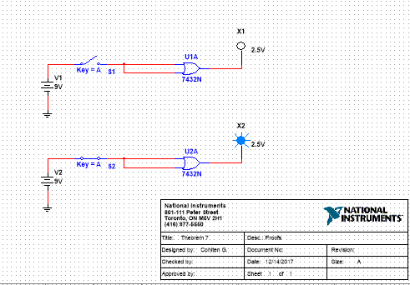
Week 2
Boolean theorems
Review proof 7

Slide 8
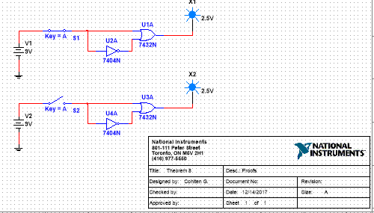
Week 2
Boolean theorems
Review proof 8

Slide 9
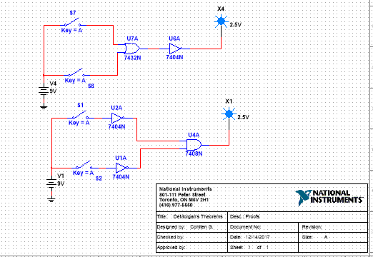
Week 2 demorgans theorems
Review proof 1

Slide 10
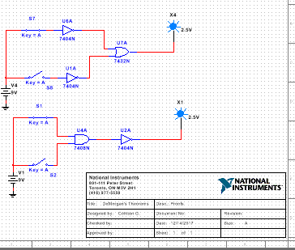
Week 2 demorgans theorems
Review proof 2

Slide 11
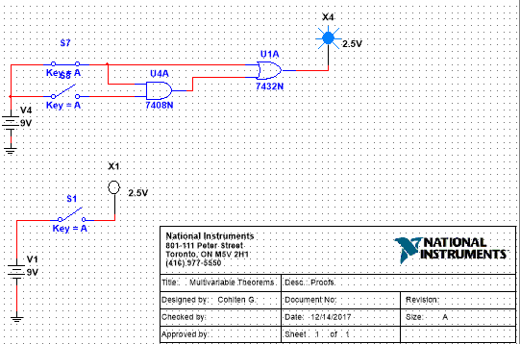
Week 2
Multivariable Theorems
Review theorem 14

Slide 12
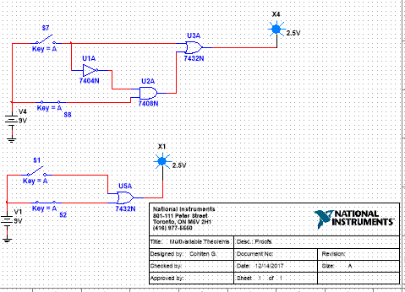
Week 2
Multivariable Theorems
Review theorem 15

Slide 13
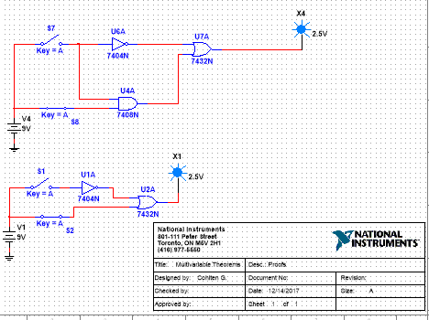
Week 2
Multivariable Theorems
Review theorem 15b

Slide 14
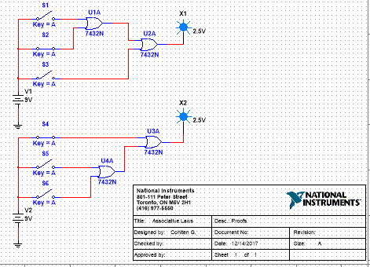
Week 2
Multivariable Theorems
Review associative law 1

Slide 15
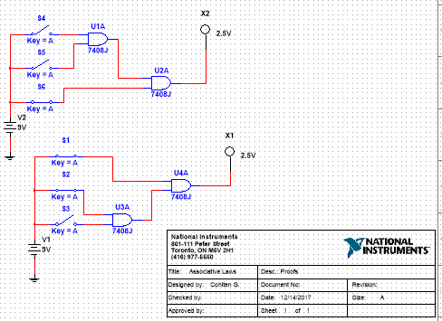
Week 2
Multivariable Theorems
Review associative law 2

Slide 16
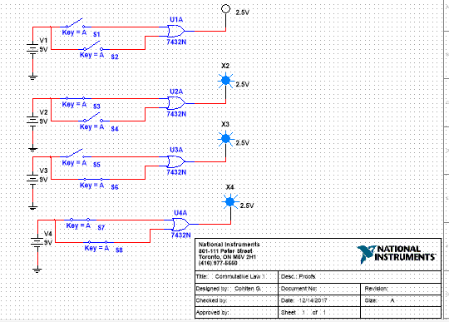
Week 2
Multivariable Theorems
Review commitative law 1

Slide 17
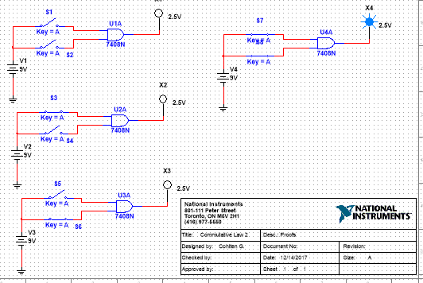
Week 2
Multivariable Theorems
Review commitative law 2

Slide 18
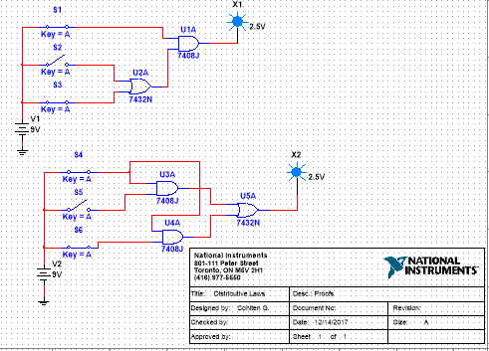
Week 2
Multivariable Theorems
Review distributive law 1

Slide 19
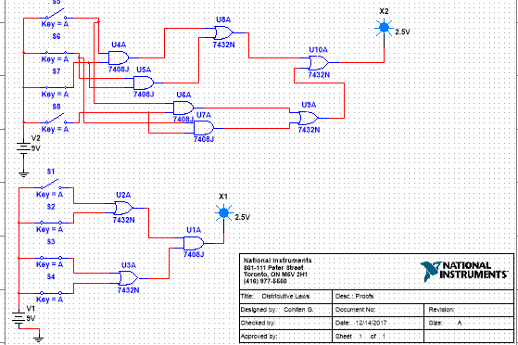
Week 2
Multivariable Theorems
Review distributive law 2

Slide 20
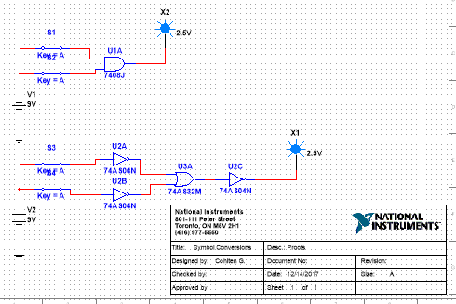
Week 2 symbol conversion
Review and gate

Slide 21
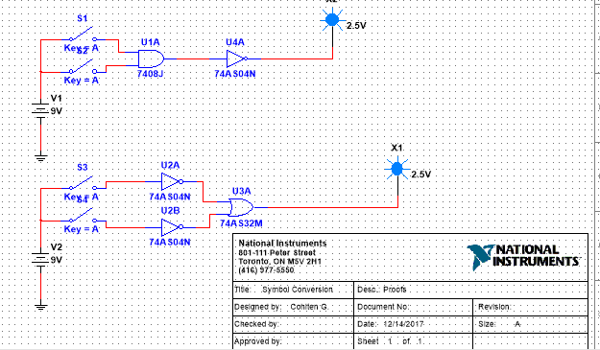
Week 2 symbol conversion
Review nand gate

Slide 22
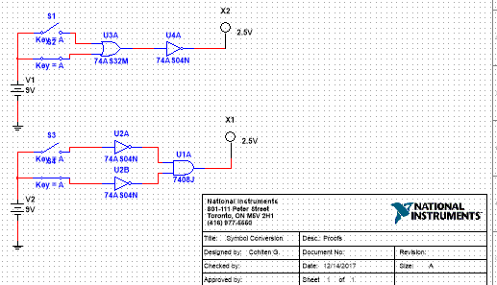
Week 2 symbol conversion
Review nor gate

Slide 23
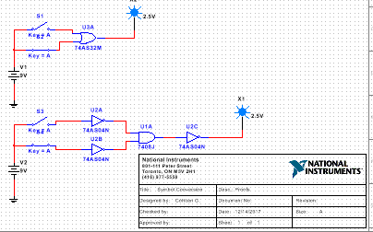
Week 2 symbol conversion
Review or gate

Slide 24
Week 5 mini lou
Objectives
Selected areas covered in this lecture:
  Building a digital model in Multisim based on truth table
  Using 74LS283 4-Bit Binary Full Adders With Fast Carry
  Common Anode and Common Cathode 7 Segment Displays

Slide 25
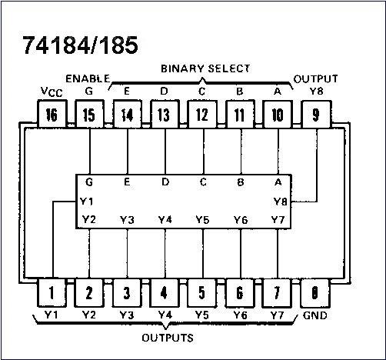

Introduction
Some parts that existed and provide a unique function may become obsolete so you can no longer buy them. Old designs that use these parts must be redesigned or the parts may need to be replaced with new technology. This is true for the
74185 BCD-to-Binary and Binary-to-BCD Converters

Slide 26
2-4 BCD Code
Binary Coded Decimal (BCD) is a widely used
way to present decimal numbers in binary form.
  Combines features of both decimal and binary systems.
    Each digit is converted to a binary equivalent.
BCD is not a number system.
  It is a decimal number with each digit encoded
  to its binary equivalent.
A BCD number is not the same as a straight binary number.
  The primary advantage of BCD is the relative
  ease of converting to and from decimal.
Copyright ©2007 by Pearson Education, Inc.
Columbus, OH 43235
All rights reserved.

Slide 27
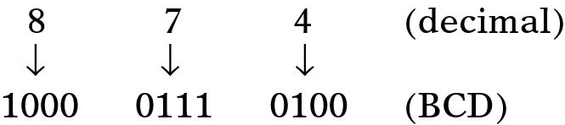
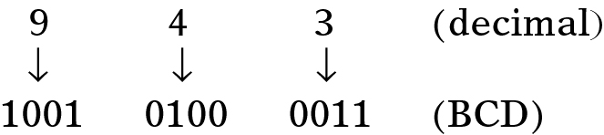
2-4 BCD Code
Convert the number 874₁₀ to BCD:
  Each decimal digit is represented using 4 bits.
    Each 4-bit group can never be greater than 9.
Reverse the process to convert BCD to decimal.
Copyright ©2007 by Pearson Education, Inc.
Columbus, OH 43235
All rights reserved.

Slide 28
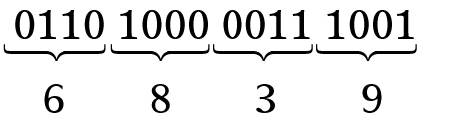
2-4 BCD Code
Convert 0110100000111001 (BCD) to its
decimal equivalent.
Divide the BCD number into four-bit
groups and convert each to decimal.
Copyright ©2007 by Pearson Education, Inc.
Columbus, OH 43235
All rights reserved.

Slide 29
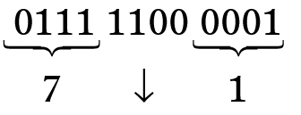
2-4 BCD Code
Convert BCD 011111000001 to its decimal equivalent.
The forbidden group represents
an error in the BCD number.
Copyright ©2007 by Pearson Education, Inc.
Columbus, OH 43235
All rights reserved.

Slide 30
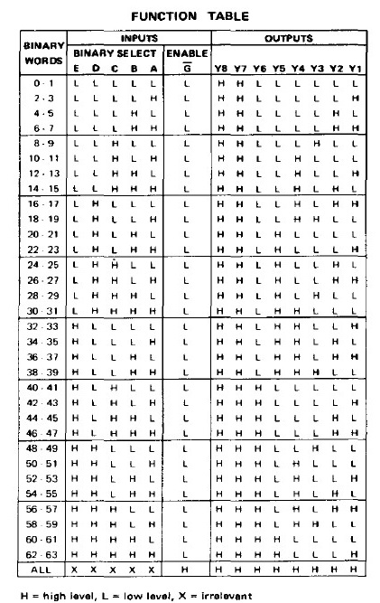
74185
The 74185 converts Binary to BCD code but it is an obsolete part, i.e. you can no longer buy it.
Also, Multisim does not have a model for it so we could build a model for it and use it to design a replacement part using combinational logic. All we need is the “truth table”

Slide 31

3 bit adder with display
We want to build a two 3 bit circuit that can display the results as a two digit BCD using seven segment LEDs
Copyright ©2007 by Pearson Education, Inc.
Columbus, OH 43235
All rights reserved.

Slide 32
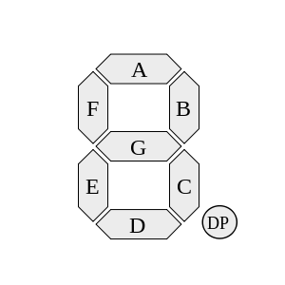
The 7 Segment Display
So lets start at the end and try to understand 7 segment displays. There are two common types: common cathode and common anode. Each LED has a letter from “A” to “G” associated with it. Some also have a “DP” decimal point. To illuminate a segment you must apply
Copyright ©2007 by Pearson Education, Inc.
Columbus, OH 43235
All rights reserved.

Slide 33
Multisim – Seven Segment Display
Here is how you would bias a Common Anode 7 Segment Display
Copyright ©2007 by Pearson Education, Inc.
Columbus, OH 43235
All rights reserved.

Slide 34
Multisim – Seven Segment Display
Here is how you would bias a Common Cathode 7 Segment Display
Copyright ©2007 by Pearson Education, Inc.
Columbus, OH 43235
All rights reserved.

Slide 35
Multisim – BCD with Common Anode 7 Segment Display
Here is how you would drive a Common Anode 7 Segment Display with a 74LS47
Copyright ©2007 by Pearson Education, Inc.
Columbus, OH 43235
All rights reserved.

Slide 36
Multisim – BCD with Common Cathode 7 Segment Display
Here is how you would drive a Common Cathode 7 Segment Display with a 74LS48
Copyright ©2007 by Pearson Education, Inc.
Columbus, OH 43235
All rights reserved.

Slide 37


Use Excel to build the model
Here are the steps to build the code for the model using Excel
Copyright ©2007 by Pearson Education, Inc.
Columbus, OH 43235
All rights reserved.

Slide 38
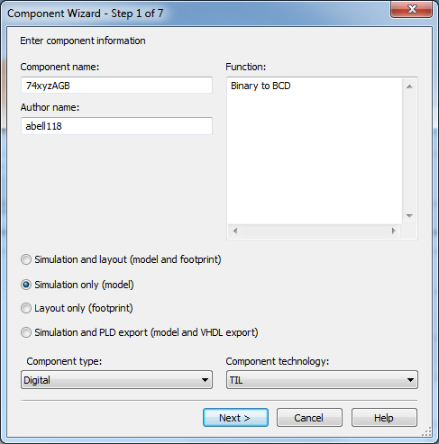
Now build the model
Launch the Component Wizard in Multisim
Name your component and describe its function
It should be a “Simulation only”, Digital model
Copyright ©2007 by Pearson Education, Inc.
Columbus, OH 43235
All rights reserved.

Slide 39
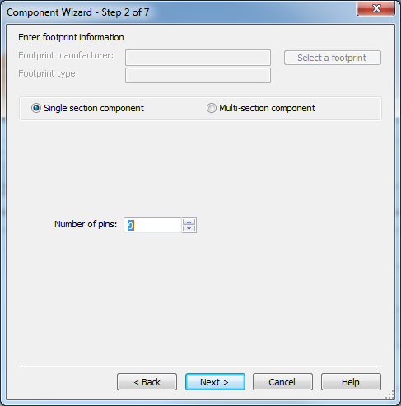
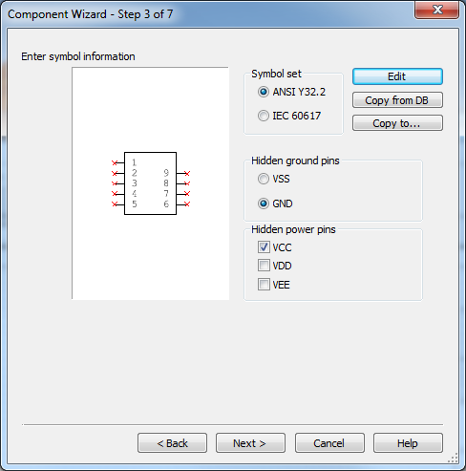
Now build the model
It only has 9 pins: 4 inputs and 5 outputs
Will need to adjust the symbol to put the inputs on the left and outputs on the right
Copyright ©2007 by Pearson Education, Inc.
Columbus, OH 43235
All rights reserved.

Slide 40
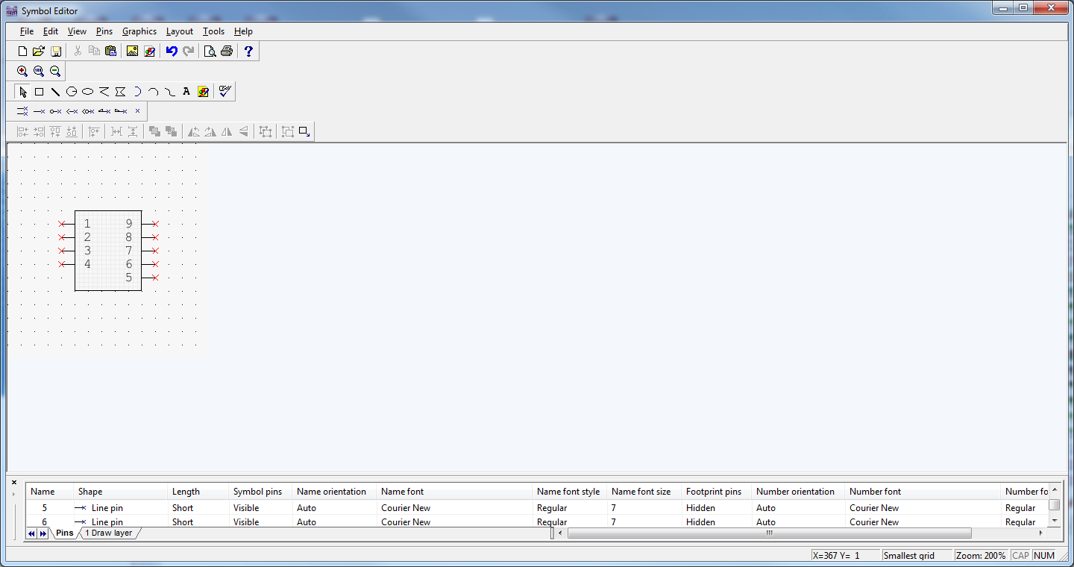
Now build the model
Modify the symbol with the Symbol Editor
Copyright ©2007 by Pearson Education, Inc.
Columbus, OH 43235
All rights reserved.

Slide 41
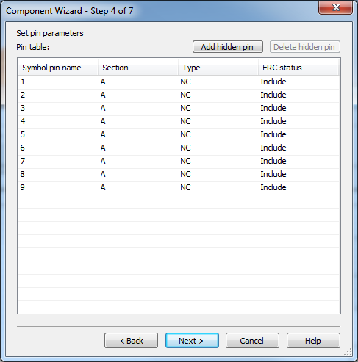
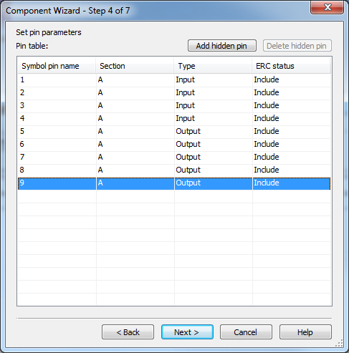
Now build the model
Define the inputs as inputs and outputs as outputs
Copyright ©2007 by Pearson Education, Inc.
Columbus, OH 43235
All rights reserved.

Slide 42
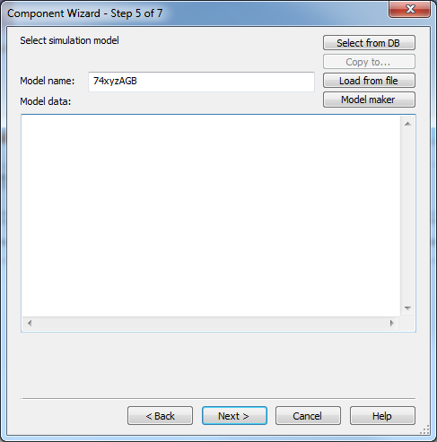
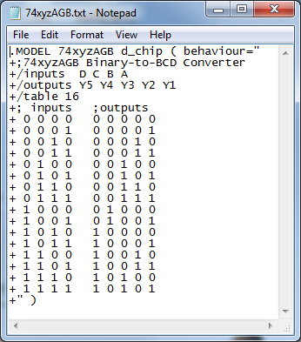
Now build the model
Insert the model for the part.
To do this it is good to create a text file and pull everything together
For more info: http://forums.ni.com/ni/attachments/ni/370/6606/1/d_chip.pdf
This is a digital part so it should have this sort of header because you are using a truth table.
Everything else based on the spreadsheet
Copyright ©2007 by Pearson Education, Inc.
Columbus, OH 43235
All rights reserved.

Slide 43
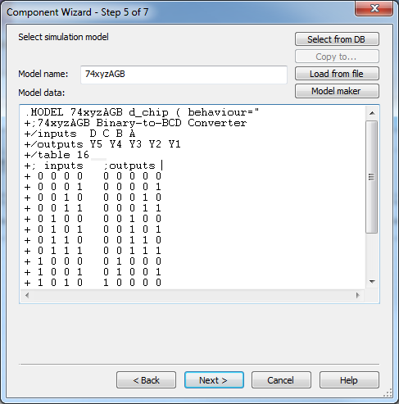
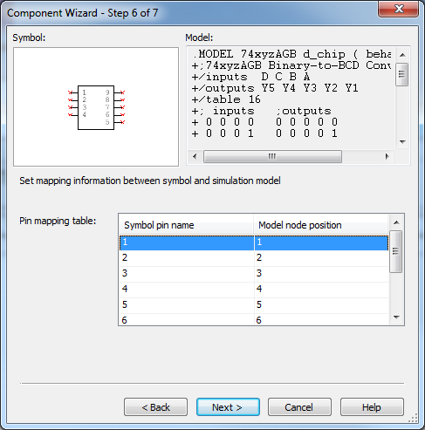
Now build the model
Step 5 is the real simulation model
Also need to connect the simulation model to the symbol pins. In our case we don’t need to do anything because model and symbol pins align.
Copyright ©2007 by Pearson Education, Inc.
Columbus, OH 43235
All rights reserved.

Slide 44
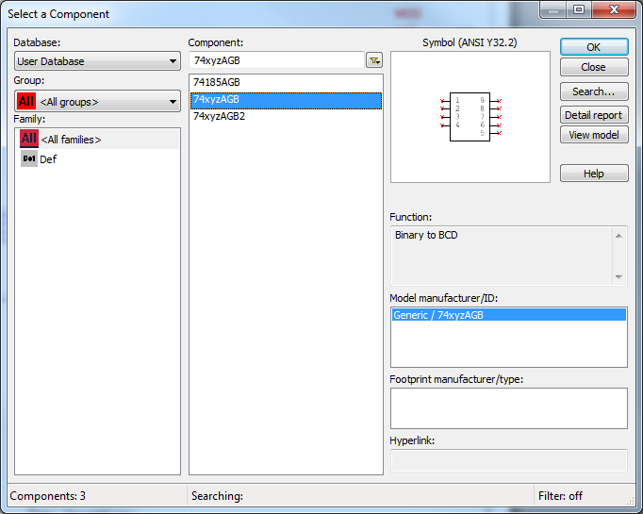
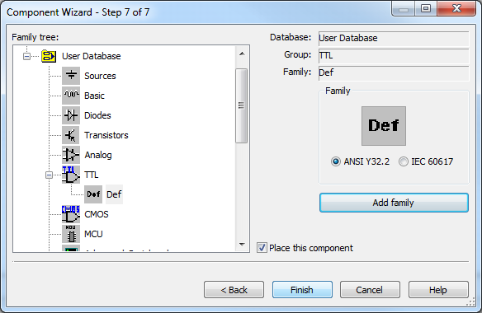
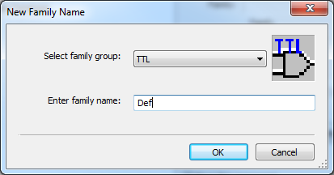
Now build the model
Final step is to save it in the library
Afterwards we can find the part in the User Database.
Copyright ©2007 by Pearson Education, Inc.
Columbus, OH 43235
All rights reserved.

Slide 45
Now we can test the model
It works!
Copyright ©2007 by Pearson Education, Inc.
Columbus, OH 43235
All rights reserved.

Slide 46
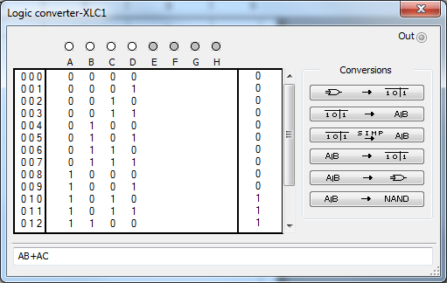
Build a circuit for the model
Use the logic converter and extract the Booleans
Then build and test the Boolean equivalent circuit
Copyright ©2007 by Pearson Education, Inc.
Columbus, OH 43235
All rights reserved.

Slide 47
Build a circuit for the model
It works! We can now build it …
Copyright ©2007 by Pearson Education, Inc.
Columbus, OH 43235
All rights reserved.

Slide 48
Design, Build and Test
Based on the simulation results build the 3 Bit Adder with a two digit 7 segment display.
Option 1 use combinational logic for Binary to BCD conversion
Option 2 use Arduino or Basic Stamp for conversion
Option 3 use EEPROM for conversion
Option 4 use CPLD Xilinx board for conversion
Copyright ©2007 by Pearson Education, Inc.
Columbus, OH 43235
All rights reserved.

Slide 49
Lab 9 procedure
Learn how the Asynchronous Counter works
This lab was only done by another lab partner named Htet Tee.
All information was gathered by him only.
Copyright ©2007 by Pearson Education, Inc.
Columbus, OH 43235
All rights reserved.

Slide 50
Lab 9 equipment
Breadboard
Function Generator
Oscilloscope
74LS112
74LS08
74LS11
Wires
This lab was only done by another lab partner named Htet Tee.
All information was gathered by him only.
Copyright ©2007 by Pearson Education, Inc.
Columbus, OH 43235
All rights reserved.

Slide 51
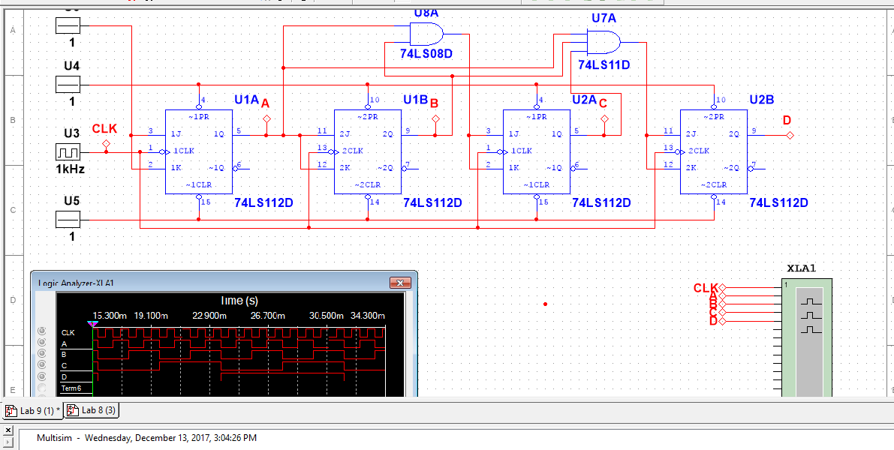
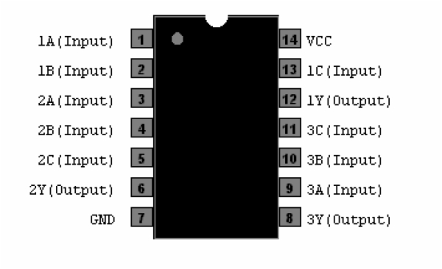
Lab 9
http://ivytechengineering.com/info/stores/74ls/files/74ls112.pdf
http://ivytechengineering.com/info/stores/74ls/files/74ls08.pdf
http://ivytechengineering.com/info/stores/74ls/files/74ls11.pdf
This lab was only done by another lab partner named Htet Tee.
All information was gathered by him only.
Copyright ©2007 by Pearson Education, Inc.
Columbus, OH 43235
All rights reserved.

Slide 52
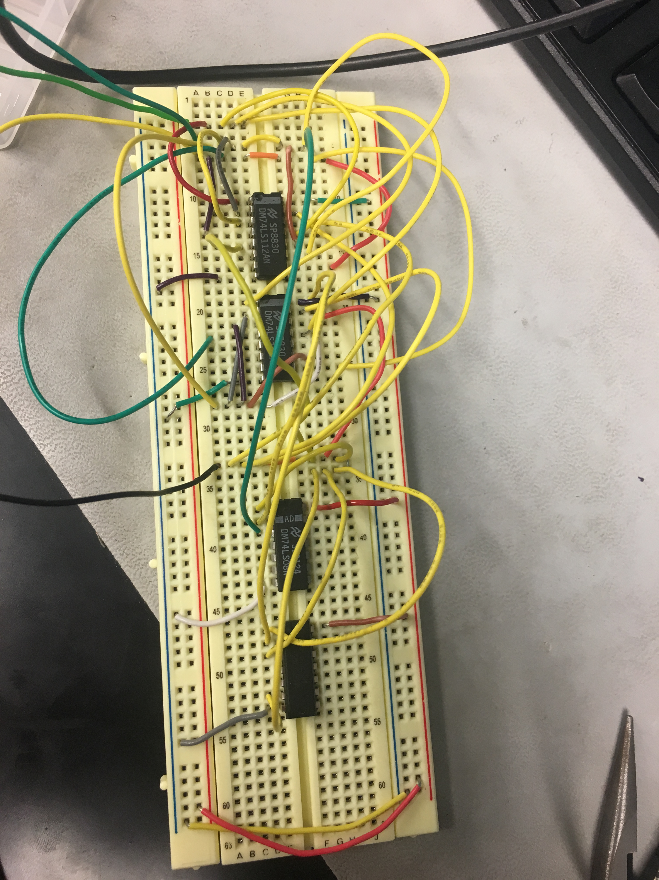
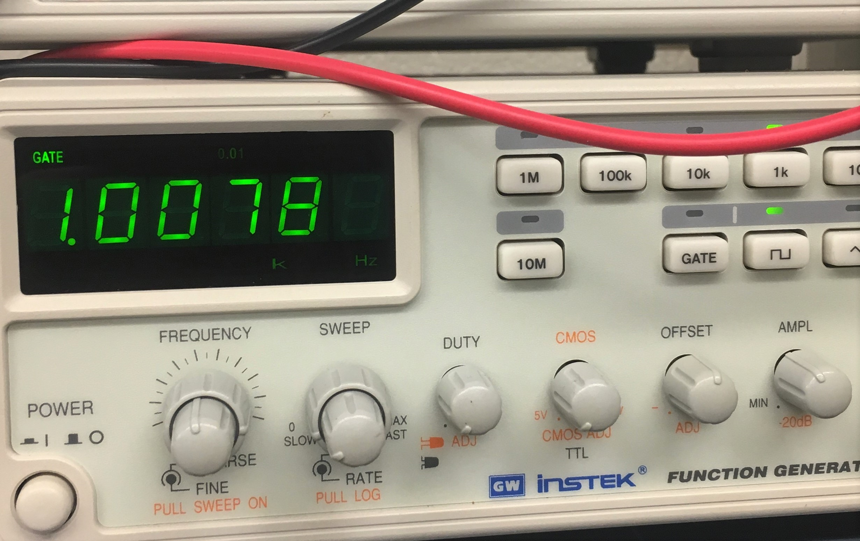
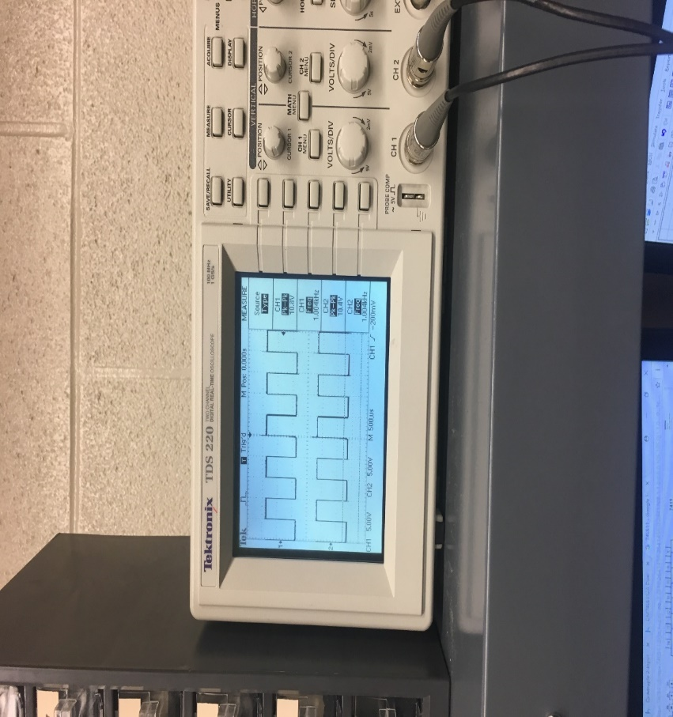
Lab 9
This lab was only done by another lab partner named Htet Tee.
All information was gathered by him only.
Copyright ©2007 by Pearson Education, Inc.
Columbus, OH 43235
All rights reserved.

Slide 53
Lab 9 observations
After working on lab-8, this lab is easier to do. The only problem that I was struggling is that I have to add more chip into the board. Learning how to understand different chips is a bit problem for me. Overall the result was as expected. I enjoy building lab-9.
This lab was only done by another lab partner named Htet Tee.
All information was gathered by him only.
Copyright ©2007 by Pearson Education, Inc.
Columbus, OH 43235
All rights reserved.

Slide 54
Week 5
1 clk in, 3 clk out procedure
Make 1 clock input and have a 3 clock output
Copyright ©2007 by Pearson Education, Inc.
Columbus, OH 43235
All rights reserved.

Slide 55
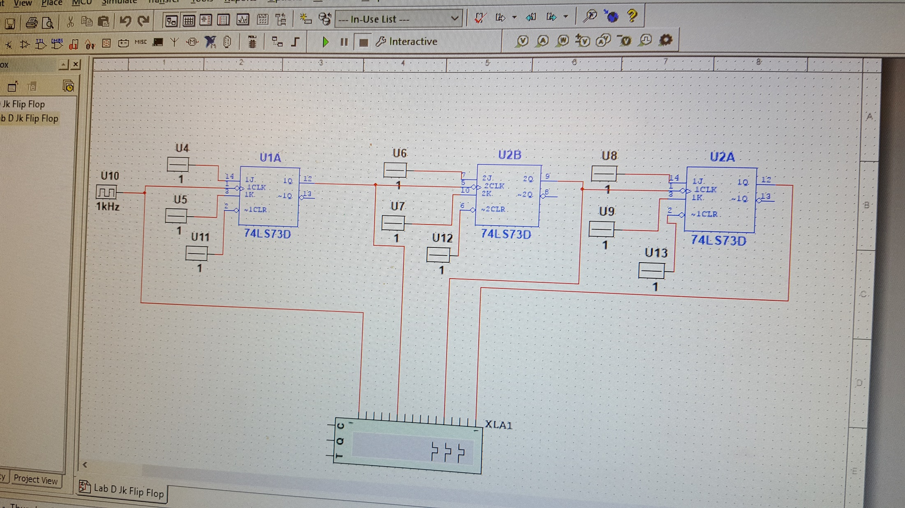
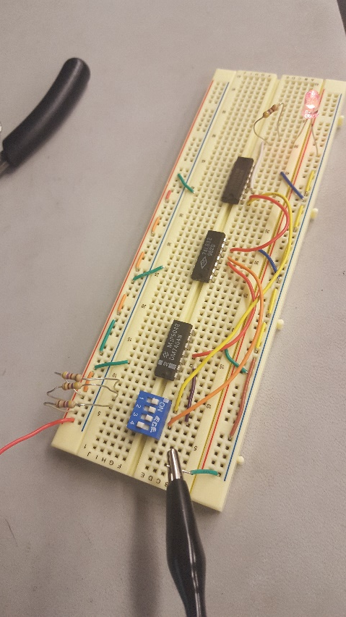
Week 5
1 clk in, 3 clk out
Copyright ©2007 by Pearson Education, Inc.
Columbus, OH 43235
All rights reserved.

Slide 56
Week 5
1 clk in, 3 clk out observations
This lab was a good refresher. It wasn’t too difficult to do.
Copyright ©2007 by Pearson Education, Inc.
Columbus, OH 43235
All rights reserved.

Slide 57
mini lou total equipment
Breadboard
220 resistor (20-22)
Wires
74ls283
74ls04 (2)
74ls08 (4)
74ls32 (2)
74ls47 (2)
Seven segment display
4 switch output (2)
* Items in parentheses are based upon quantities of items
Copyright ©2007 by Pearson Education, Inc.
Columbus, OH 43235
All rights reserved.

Slide 58
mini lou
Data sheets
74ls283
http://ivytechengineering.com/info/stores/74ls/files/74ls283.pdf
74ls04
http://ivytechengineering.com/info/stores/74ls/files/74ls04.pdf
74ls08
http://ivytechengineering.com/info/stores/74ls/files/74ls08.pdf
74ls32
http://ivytechengineering.com/info/stores/74ls/files/74ls32.pdf
74ls47
http://ivytechengineering.com/info/stores/74ls/files/74ls47.pdf
Seven segment display
http://ivytechengineering.com/info/stores/optoelec/files/7segled.pdf
Copyright ©2007 by Pearson Education, Inc.
Columbus, OH 43235
All rights reserved.

Slide 59
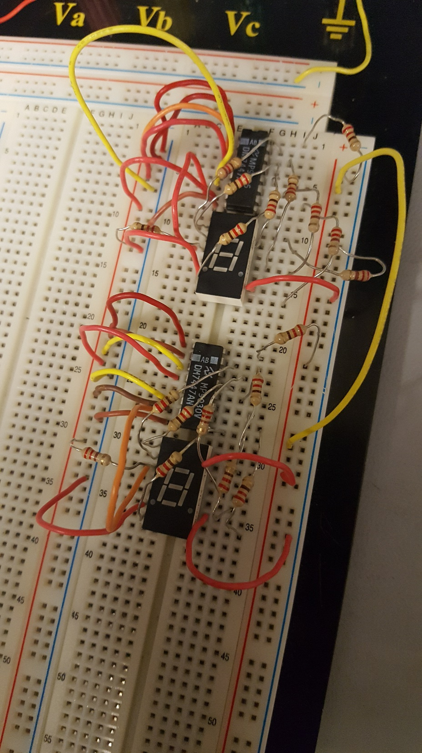

Week 6 mini lou seven segment display
Copyright ©2007 by Pearson Education, Inc.
Columbus, OH 43235
All rights reserved.

Slide 60
Week 6 mini lou observations
We started with the seven segment display portion of the mini lou because it would be easier than starting at the beginning with the switches. It took a little bit to figure out which pins of the displays needed to be constant hot/ground.
Copyright ©2007 by Pearson Education, Inc.
Columbus, OH 43235
All rights reserved.

Slide 61




Week 8 mini lou
Copyright ©2007 by Pearson Education, Inc.
Columbus, OH 43235
All rights reserved.

Slide 62
Week 8 mini lou observations
We began to work on the convertor and adding the switches this week. The convertor was the biggest problem just because of how many wires that are needed and how much space it takes up.
Copyright ©2007 by Pearson Education, Inc.
Columbus, OH 43235
All rights reserved.

Slide 63
Week 9 mini lou observations
This week was mostly trouble shooting the convertor and the seven segment display.
Copyright ©2007 by Pearson Education, Inc.
Columbus, OH 43235
All rights reserved.

Slide 64

Week 10 mini lou
Before cleaning up the convertor wires…
Copyright ©2007 by Pearson Education, Inc.
Columbus, OH 43235
All rights reserved.

Slide 65


Week 10 mini lou
Almost cleaned up…
Cleaned up convertor
Copyright ©2007 by Pearson Education, Inc.
Columbus, OH 43235
All rights reserved.

Slide 66
Week 10 mini lou observations
This week was a clean up week. We were able to cut wires and fit them to the board to make it look clean and less cluttered. This was really beneficial not only by looks but it helped teach us how to do it for the future. It’s not something that you can rush through or do fast. You have to take your time, to an extent, if you want it down well.
Copyright ©2007 by Pearson Education, Inc.
Columbus, OH 43235
All rights reserved.

Slide 67
Week 11 mini lou observations
This week was another troubleshooting week. There was still some things wrong with the design we made. We found that some of the wires were misplaced.
Copyright ©2007 by Pearson Education, Inc.
Columbus, OH 43235
All rights reserved.

Slide 68


Week 12 mini lou
Copyright ©2007 by Pearson Education, Inc.
Columbus, OH 43235
All rights reserved.

Slide 69
Week 12 mini lou observations
We began to look at previously made mini lou boards that function without the subtractor, they just added. We began to compare the boards and make adjustments to ours. Later on in that class session, we were given the new task to add stuff to the previously made mini lous to make a completed one.
Copyright ©2007 by Pearson Education, Inc.
Columbus, OH 43235
All rights reserved.

Slide 70



Week 13 mini lou
Copyright ©2007 by Pearson Education, Inc.
Columbus, OH 43235
All rights reserved.

Slide 71
Week 13 mini lou observations
Getting closer to the end of the semester, we were running out of time. We didn’t care as much about how clean it looked, as long as it worked. With the task of the previous week, we had an almost finished mini lou. It was functional but didn’t function correctly. We had to move on to other components of the class and put the mini lou on the side.
Copyright ©2007 by Pearson Education, Inc.
Columbus, OH 43235
All rights reserved.

Slide 72
Week 14 mini lou observations
We begun to research memory mapping but was not very successful. We did find a couple videos on how to program the chips but they were foreign videos. We found it’s user manual as well but that didn’t really give us any information on how to program the chips.
Copyright ©2007 by Pearson Education, Inc.
Columbus, OH 43235
All rights reserved.

Slide 73


Week 15 mini lou
Copyright ©2007 by Pearson Education, Inc.
Columbus, OH 43235
All rights reserved.

Slide 74
Week 15 mini lou
Observations
This week was spent by wrapping things up and getting a little further on the circuit board build of the mini lou, of what we got working.
Copyright ©2007 by Pearson Education, Inc.
Columbus, OH 43235
All rights reserved.

